Slide 1
MySQL Database
ITWA133

Slide 2
Objectives
To provide a good background of Relational Database using MySQL.
To know the importance of Database in Web Application using MySQL.
To Identify the importance of Database Structure in constructing tables.
To be familiar with the syntax in managing users and database.
To define a good structure of tables in a given database for data storage.
To be familiar in the common syntax of creating database and tables and the correct data type to be used for each field.

Slide 3
Introduction to Databases
Database – is an ordered collection of information from which a computer program can quickly access.
Information stored in computer databases is actually stored in tables similar to spreadsheet.
A record in a database is a single complete set of related information.
Fields are the individual categories of information stored in a record.

Slide 4
Example: Employee Directory DB
Fields
last_name | first_name | address | city | state | zip
Blair | Dennis | 204 Spruce Lane | Brookfield | MA | 01506
Hernandez | Louis | 68 Boston Post Road | Spencer | MA | 01562
Miller | Erica | 271 Baker Hill Road | Brookfield | MA | 01515
Morinaga | Scott | 17 Ashley Road | Brookfield | MA | 01515
Picard | Raymond | 1113 Oakham Road | Barre | MA | 01531
Records (Row)
Also called as flat-file database that stores information in a single table.

Slide 5
Relational Database
Stores information across multiple related tables.
Composed of Primary Table and Related Table (child table)
Primary key is a field that contains a unique identifier for each record in a primary table.
Foreign key is a field in a related table that refers to the primary key in a primary table.
Normalization is the process of breaking tables into multiple related tables to reduce redundant information.

Slide 6
The MySQL Database
One important aspect of database management is its querying capability.
A query is a structured set of instructions and criteria for retrieving, adding, modifying, and deleting database information.
Data Manipulation Language (DML) is use for creating queries.
Structured Query Language (SQL) has a standard data manipulation language among many database management system.

Slide 7
Open Source Databases
Either as outgrowths of earlier academic research (PostgreSQL)
Developments of lightweight storage tools for websites (MySQL)
Open-sourced commercial products (InterBase)

Slide 8
A Bit History
Most popular open source relational database
An Australian academician named David Hughes (Hughes Technologies) wrote a very lightweight database engine called mSQL (short for mini SQL) -- it didn't implement a number of features required for full ANSI SQL certification, but it was very small and very fast.
mSQL was distributed as shareware
incapable of doing a number of essential things -- like joins

Slide 9
A Bit History
improvement was done by a Swedish programmer Monty Widenius
MySQL rapidly grew until, although it's still a fast, light database, it's also a pretty powerful one.
MySQL is written in C++, compiles using GNU gcc, and is pretty portable -- it has been ported to OS/2, Windows 95 and NT, as well as a variety of flavours of UNIX

Slide 10
Features of MySQL
According to the article of Ian Gilfillan in 2004, the following are the claimed features of MySQL:
High availability
High scalability
High performance

Slide 11
Connecting to MySQL : Console Base
Console Base
mysql >
Go to the Command Window
Start\Run
Type command or cmd
Go to the MySQL path
C:\xampp\mysql\bin\mysql –u root –p
C:\xampp\mysql\bin\mysql –u root
**Enter password if there is any.
Type commands in MySQL prompt which looks like this:
mysql >

Slide 12
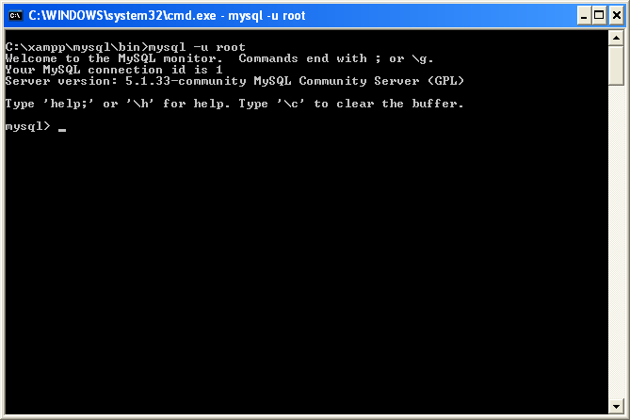
MySQL Log In

Slide 13
MySQL Prompts
Prompt | Meaning
mysql> | Ready for a new command
-> | Waiting for the next line of multiple line command.
‘> | Waiting for next line, waiting for completion of a string that began with single quote (‘ ‘ ‘).
“> | Waiting for next line, waiting for completion of a string that began in double quote (‘ “ ‘).
`> | Waiting for next line, waiting for completion of an identifier that began with a backtick (‘ ` ‘).
/*> | Waiting for next line, waiting for completion of a comment that began with /*.

Slide 14
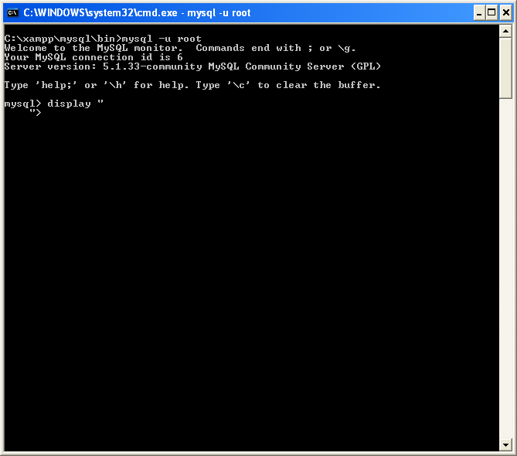
Example

Slide 15
Basic Commands
To clear command:
mysql > \c
Get status from the server:
mysql > status
mysql > \s

Slide 16
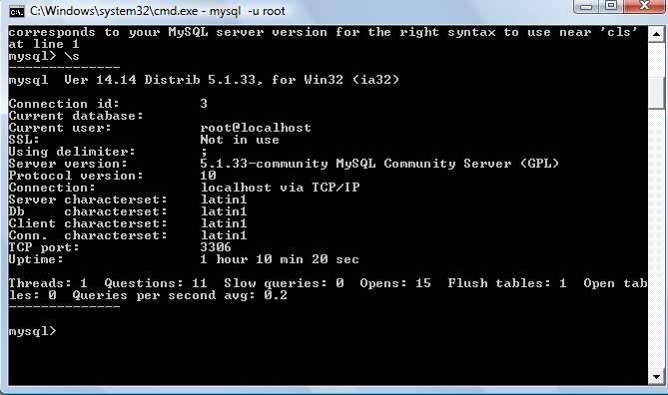
Basic Commands

Slide 17
Basic Commands
Need help?:
mysql > \h
mysql > ?
mysql > \?
mysql > help
To display the SQL version:
mysql > select version();

Slide 18
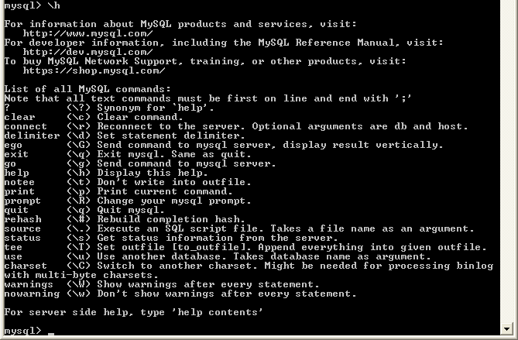
Example

Slide 19
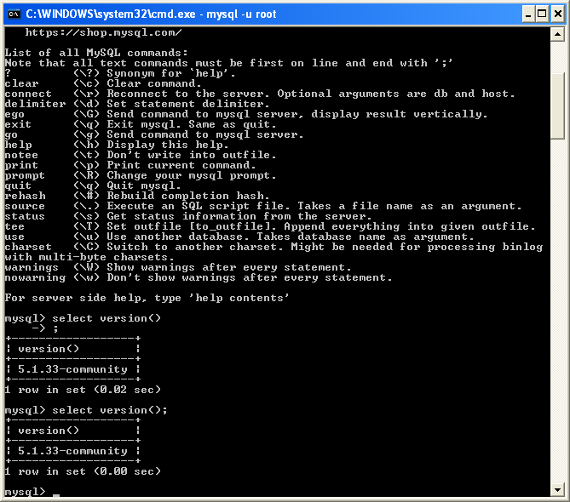
Example

Slide 20
Basic Commands
Display current user:
mysql > select user();
Display current date:
mysql > select current_date();
Display today’s date and time:
mysql > select now()

Slide 21
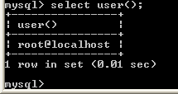
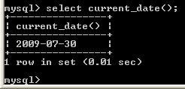
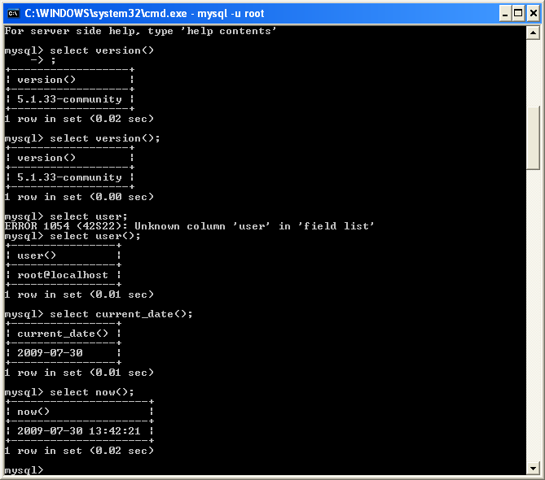
Example

Slide 22
Basic Commands
To quit
mysql > \q
mysql > quit
mysql > exit

Slide 23
MySQL
Data manipulation Language (DML)
Create, Select, Insert, Update, Delete

Slide 24
Database Creation
Syntax:
CREATE DATABASE <databasename>;
mysql> CREATE DATABASE DBStudent;
Showing and Using the Database:
mysql> SHOW databases;
Syntax: USE <database name>;
mysql> USE DBStudent;
Note: It should display Query OK, 1 row affected as a result.

Slide 25
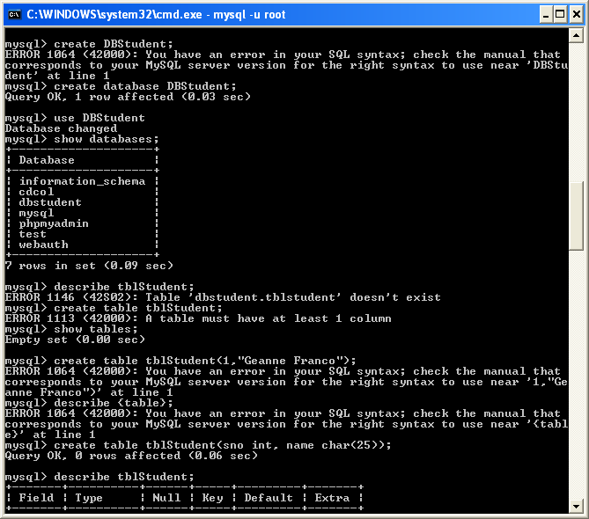
Example

Slide 26
Table Creation
Syntax:
CREATE TABLE <table name> (field name field type(size)
condition...);
mysql> CREATE TABLE tblStudent(id int(5) primary key not null auto_increment, name char(25));
Display the structure of the table:
Syntax: DESCRIBE <table name>;
mysql > DESCRIBE tblStudent;
Displaying the list of table:
mysql> SHOW tables;

Slide 27
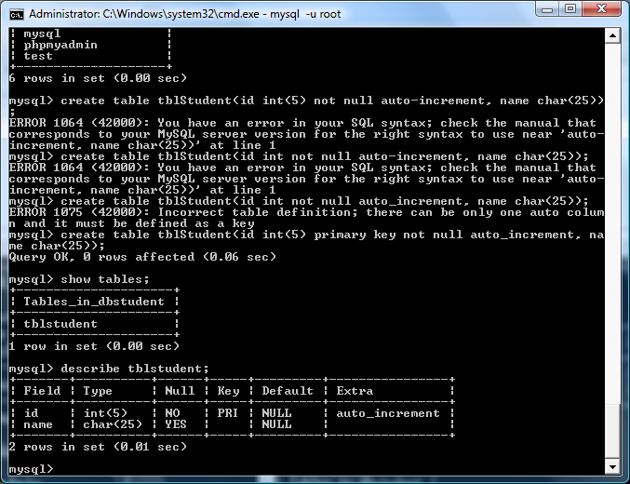
Sample Screen

Slide 28
Adding of Primary Key
mysql> create table primaryTable (id int not null auto_increment, name varchar(30), primary key (id));
mysql> create table keyTable (id int not null auto_increment, name varchar(30), key (id));
mysql> create table uniqueTable (id int not null auto_increment, name varchar(30), unique key (id));

Slide 29
Field Data Types
Type | Range | Storage
BOOL | -128 to 127; 0 is considered false | 1 byte
INT or INTEGER | -2147483648 to 2147483647 | 4 bytes
FLOAT | A small number with a floating decimal point. | 4 bytes
DOUBLE | A large number with a floating decimal point. | 4 bytes
DATE | YYYY-MM-DD | Varies
TIME | HH:MM:SS | Varies
CHAR(m) | Fixed length string between 0 to 255 characters | Number of bytes specified by m
VARCHAR(m) | Variable length string between 1 to 65,535 characters | Varies according to the number of bytes specified by m.

Slide 30
The ‘show’ Command
This time you can show additional information of a table
mysql > SHOW COLUMNS FROM tblStudent;
mysql > SHOW TABLE STATUS;
mysql > SHOW TABLE STATUS \G;
mysql > SHOW TABLE STATUS LIKE ‘tblStudent’ \G;
mysql > SHOW CREATE TABLE tblStudent \G;

Slide 31
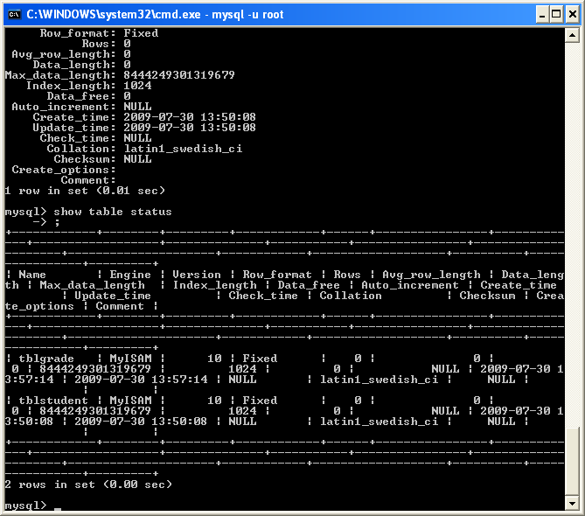
Example

Slide 32
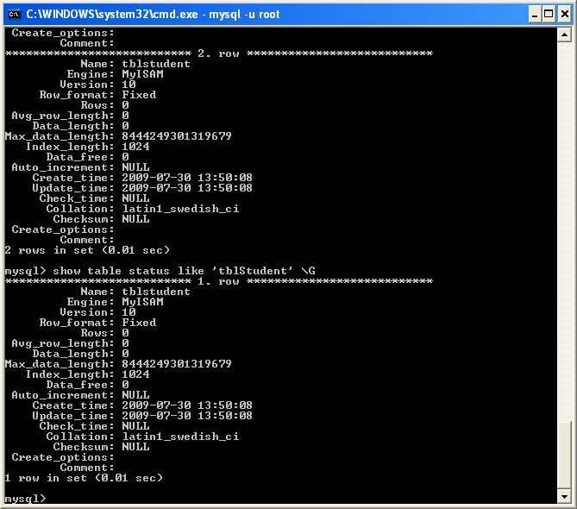
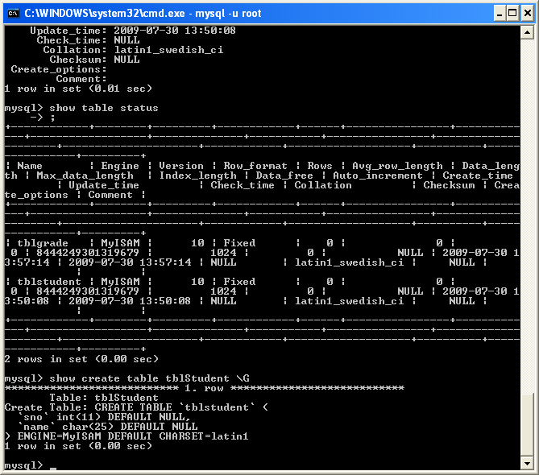
Example

Slide 33
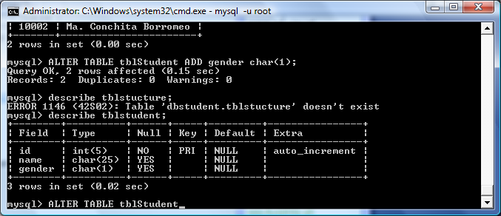
Modifying the Table Structure
Adding new column
Syntax: ALTER TABLE <table name> ADD <column name> <data type(size)>;
mysql > ALTER TABLE tblStudent ADD gender char(1);

Slide 34
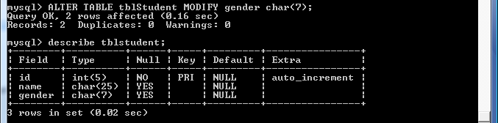
Modifying Table Structure
Changing Field Type Sizes
Syntax: ALTER TABLE <table name> MODIFY <column name> <data type(size)>;
mysql > ALTER TABLE tblStudent MODIFY gender char(7);

Slide 35
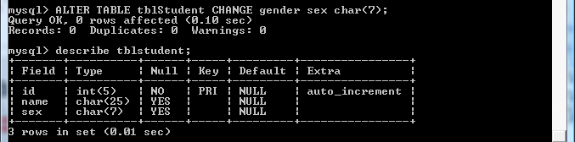
Modifying Table Structure
Changing Field Names
Syntax: ALTER TABLE <table name> CHANGE <column name> <new column name> <data type(size)>;
mysql > ALTER TABLE tblStudent CHANGE gender sex char(7);

Slide 36
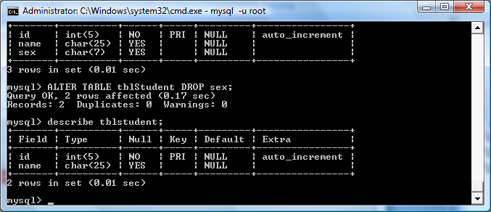
Modifying Table Structure
Dropping column
Syntax: ALTER TABLE <table name> DROP <column name>;
mysql > ALTER TABLE tblStudent DROP sex;

Slide 37
Inserting Values to your Table
Syntax: INSERT INTO <table name> VALUES (value1, value2, value3, ....);
mysql > INSERT INTO tblStudent VALUES (10001, ‘Juan Dela Cruz’);
To view use ‘SELECT’ command:
Syntax: SELECT * FROM <table name>;
mysql> SELECT * FROM tblStudent;

Slide 38
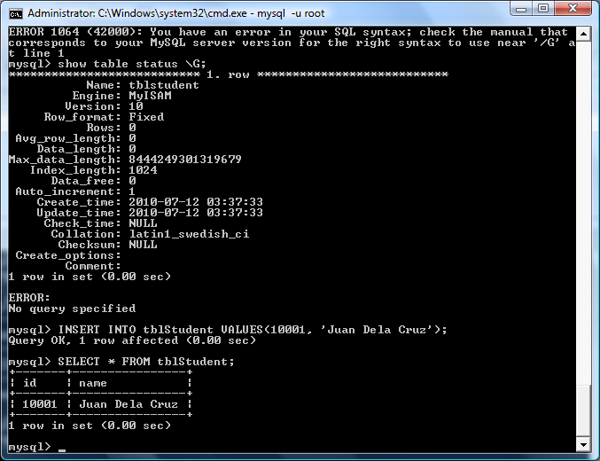
Example

Slide 39
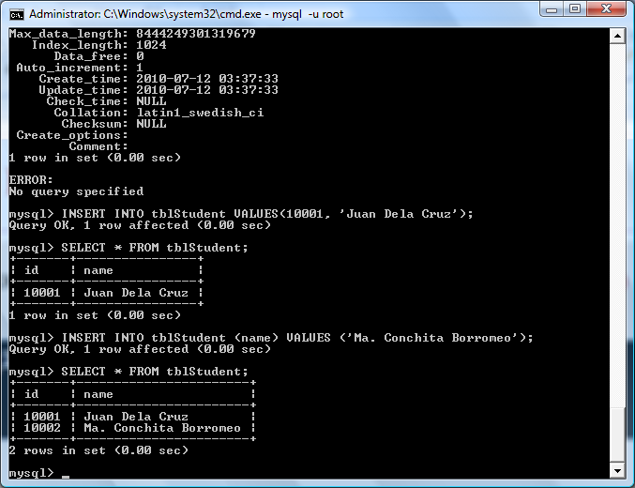
Inserting Values is a Specific Column
Syntax: INSERT INTO <table name> (column name)
VALUES (value);
mysql> INSERT INTO tblStudent (name) VALUES
(‘Ma. Conchita Borromeo’);

Slide 40
Other Structure
mysql> INSERT INTO tblStudent (id,name) VALUES (10003,’Mar Roxas’);
mysql> INSERT INTO tblStudent (name,id) VALUES (’Jojo Binay’,10004);

Slide 41
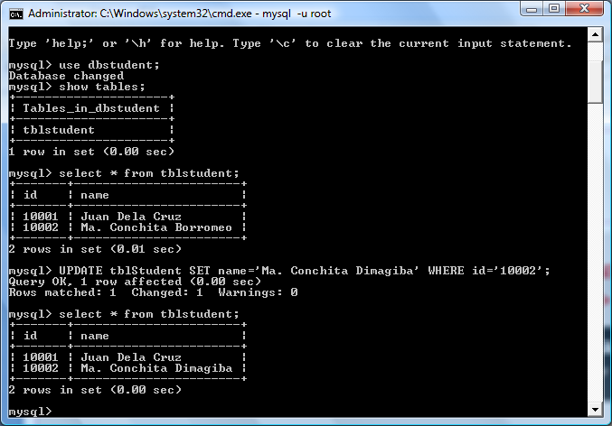
Updating the Records
Syntax: UPDATE <table name> SET <column name> = <value> WHERE <column name> = <value>;
mysql> UPDATE tblStudent SET name=‘Ma. Conchita Dimagiba’ WHERE id=‘10002’;

Slide 42
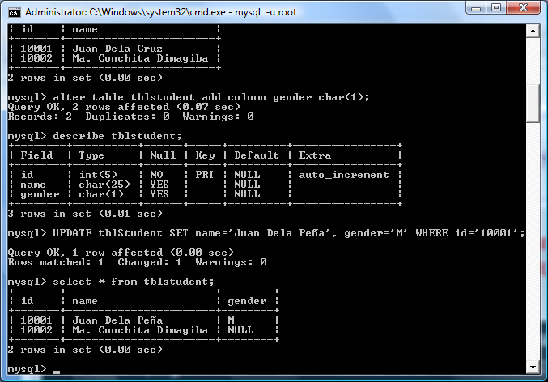
Updating Multiple Columns
Syntax: UPDATE <table name> SET <column name> = <value>, <column name> = <value> WHERE <column name> = <value>;
mysql> UPDATE tblStudent SET name=‘Juan Dela Peña’, gender=‘M’ WHERE id=‘10001’;

Slide 43
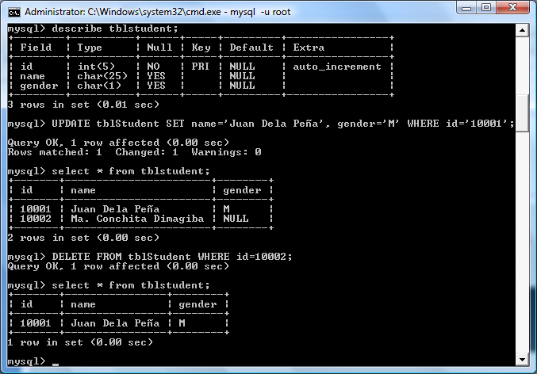
Deleting of Columns
Syntax: DELETE FROM <table name> WHERE <column name> = <value>;
mysql> DELETE FROM tblStudent WHERE id=‘10002’;

Slide 44
Deleting all data in a table
Syntax: TRUNCATE TABLE <table name>
or
mysql> TRUNCATE TABLE tblStudent;
mysql> DELETE FROM tblStudent;

Slide 45
To Delete A Table
Syntax: DROP TABLE <table name>;
mysql> DROP TABLE tblStudent;
* You remove a table from the database when it is not required. You use the DROP TABLE statement to remove a table. When you remove a table, all the data from the table is also deleted.

Slide 46
To Delete Database
Syntax: DROP DATABASE <database name>;
mysql> DROP DATABASE dbStudent;

